Slide 1
MATLAB ASSIGNMENT 5.2
GROUP 16

Slide 2
GROUP 16 MEMBERS
NO. | STUDENT NAME | REG. NO. | COURSE | SEX | GITHUB LINK
1 | KABWERU ANDREW | BU/UG/2024/5057 | WAR | M | https://github.com/kabweruandrew39-alt/Andrew.git
2 | CHEMONGES MIKIRAR | BU/UP/2024/1005 | WAR | M | https://github.com/Chemonges-mikirar/Chemonges
3 | NAGASHA RITTA | BU/UG/2024/5055 | AMI | F | https://github.com/Nagasharitah/Nagasha-Ritta.git
4 | DIKITAL JOHN | BU/UP/2024/1125 | WAR | M | https://github.com/JOHNDIKITAL/johndikitalmatlab.git
5 | SANYU JOY | BU/UP/2024/5348 | MEB | F | https://github.com/joysanyu22-cell/SANYU-JOY.git
6 | OULE SADOCK | BU/UP/2024/0844 | AMI | M | https://github.com/oulesadock25/Oule-Sadock-.git
7 | WANGUSI DAVID | BU/UP/2024/5350 | MEB | M | https://github.com/wangusid22/WANGUSI-DAVID.git
8 | SEBATIKA COLLINE | BU/UP/2024/0845 | AMI | M | https://github.com/SebyatikaColline/Sebyatika-Colline.git
9 | ATYANG MILDRED | BU/UP/2024/1019 | WAR | F | https://github.com/mildredmoreen/ATYANG-MILDRED-.git
10 | KITUTU LEONARD | BU/UP/2024/1035 | WAR | M | https://github.com/leonardkitutu1-hue/leonard-kitutu.git

Slide 3
INTRODUCTION
The above presentation involves creation of a project to develop and implement a MATLAB-based numerical model capable of estimating maize crop yield by applying principles of numerical methods, object-oriented programming, and data analysis.
SECTIONS INVOLVED include:
Data Generation and Initialization
Soil and Topographic Parameter Initialization
Maize Growth and Biomass Accumulation Modelling
Multi-Year Yield Estimation and Environmental Sensitivity Analysis
Visualization of Environmental Factors
Multi-Year Yield Analysis and Environmental Correlations
Yield Prediction Model and Accuracy Assessment
Results Display and Interpretation

Slide 4
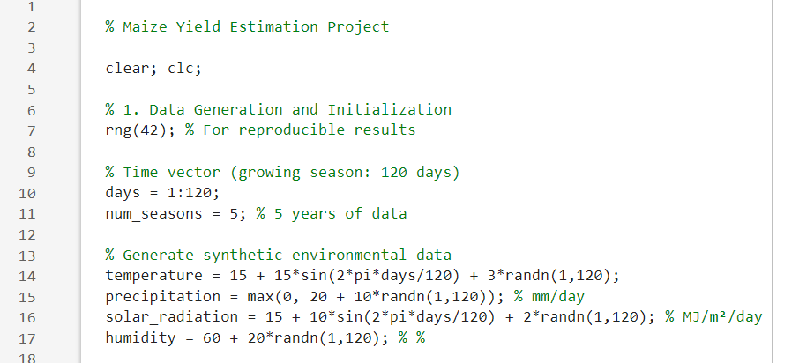
SECTION 1
This section of the MATLAB program is responsible for generating synthetic environmental data and initializing key simulation parameters that represent the conditions under which maize is grown. Since the goal of the project is to estimate maize yield based on environmental and soil factors, this part of the code sets up the input data that drive the model.

Slide 5
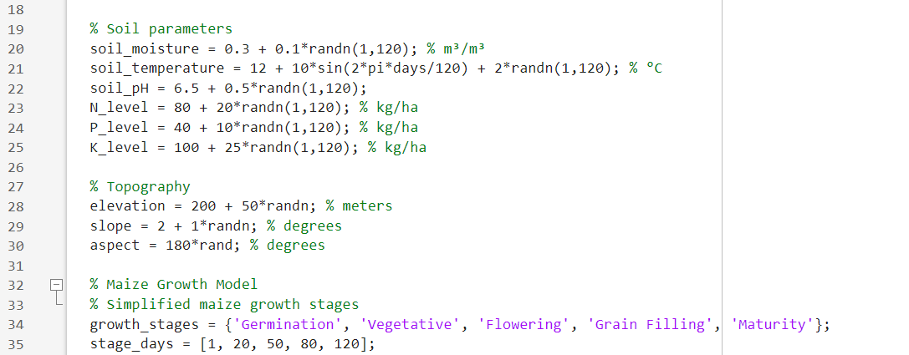
SECTION 2
This section of the program defines the soil and terrain characteristics that significantly influence maize growth and yield.
In real world crop modelling, these variables determine water and nutrient availability, soil aeration, and root development factors that directly affect biomass accumulation and, ultimately, yield.

Slide 6
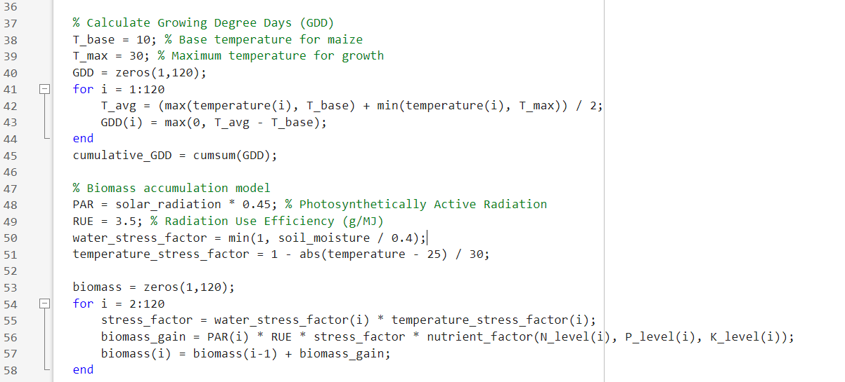
SECTION 3
This section models the thermal and physiological growth of maize using two interlinked sub-models namely:
Growing Degree Days (GDD);
Biomass Accumulation Model
crop growth simulation and yield estimation

Slide 7
SECTION 4
Multi-Year Yield Estimation and Environmental Sensitivity Analysis
This section expands the maize yield model from a single growing season to a five-year simulation (2019–2023). The goal is to evaluate how annual variations in temperature, rainfall, and soil conditions affect final maize yield.
It introduces stochastic (random) changes to environmental variables to reflect real-world climate variability and then recalculates biomass and yield for each year.
The key aspects that form up this section are Yield Estimation Using Harvest Index (HI), Multi-Year Analysis (2019–2023), Biomass Recalculation Per Season, Environmental Data Logging and Output
The output is basically:
Yields-kg-ha contains the estimated grain yield for each year.
The simulation provides a practical framework for forecasting maize yield under varying environmental and soil conditions, useful for planning and risk assessment.

Slide 8
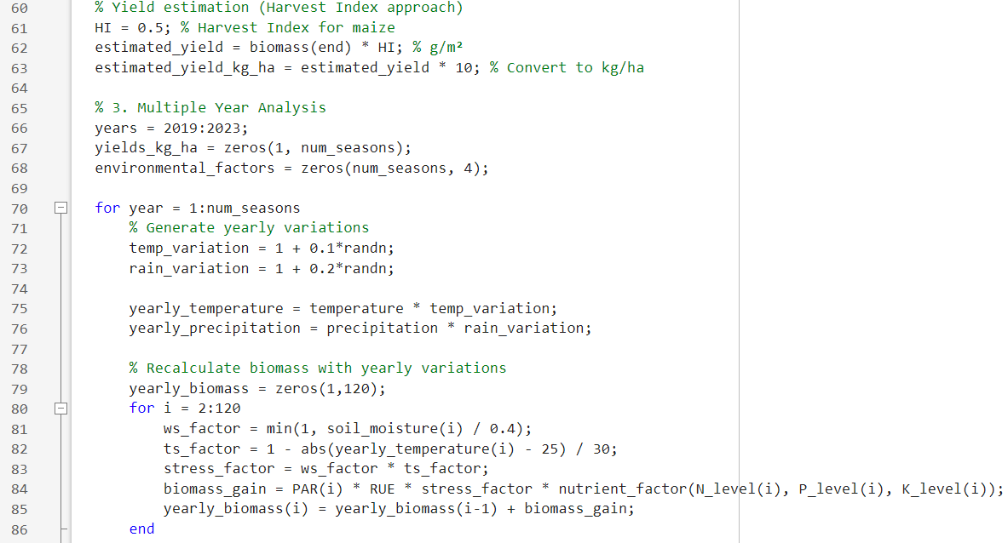

Slide 9
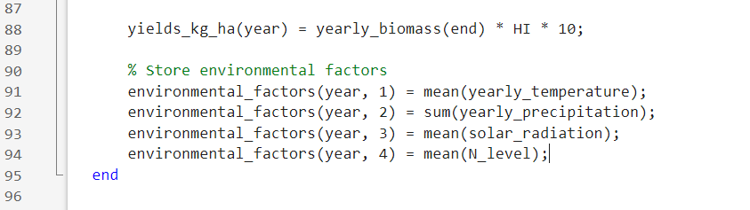

Slide 10
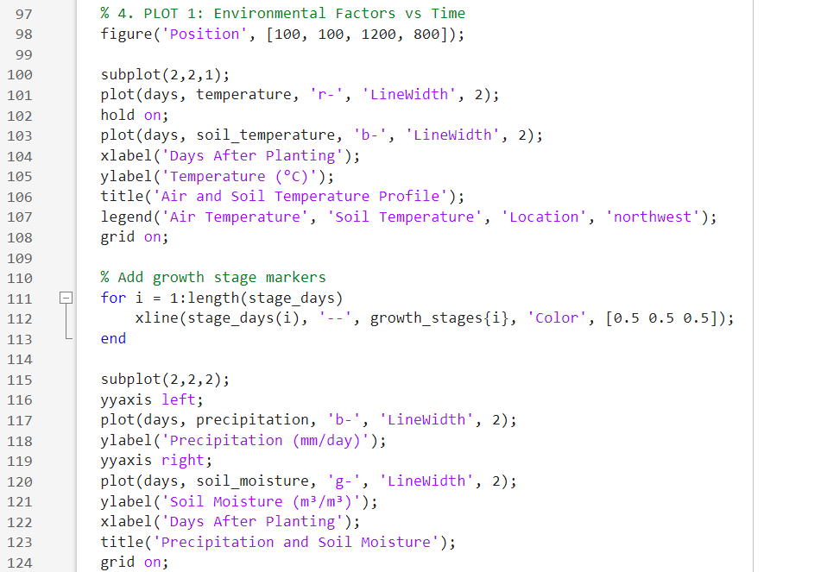
SECTION 5
This part of the code generates comprehensive plots showing the dynamics of key environmental and soil parameters during the maize growing season. Visualizing these factors helps in understanding how conditions affect crop growth and yield.

Slide 11
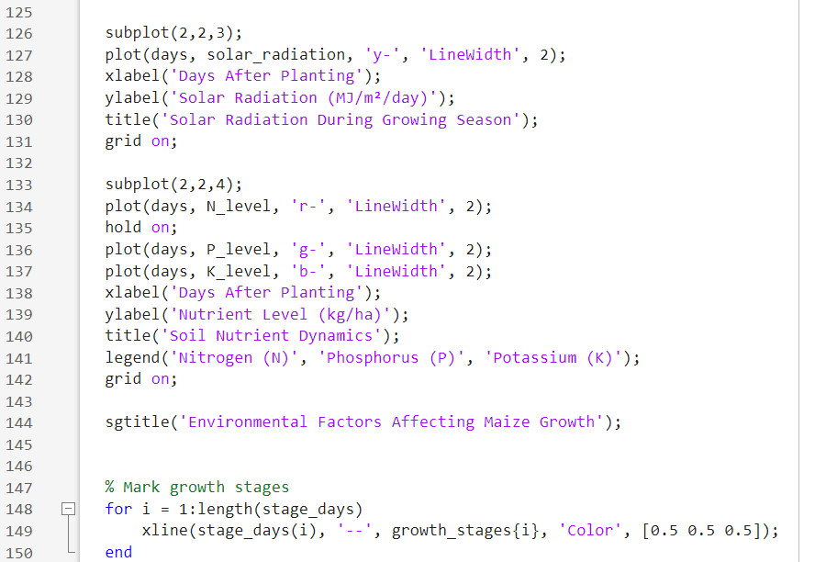

Slide 12
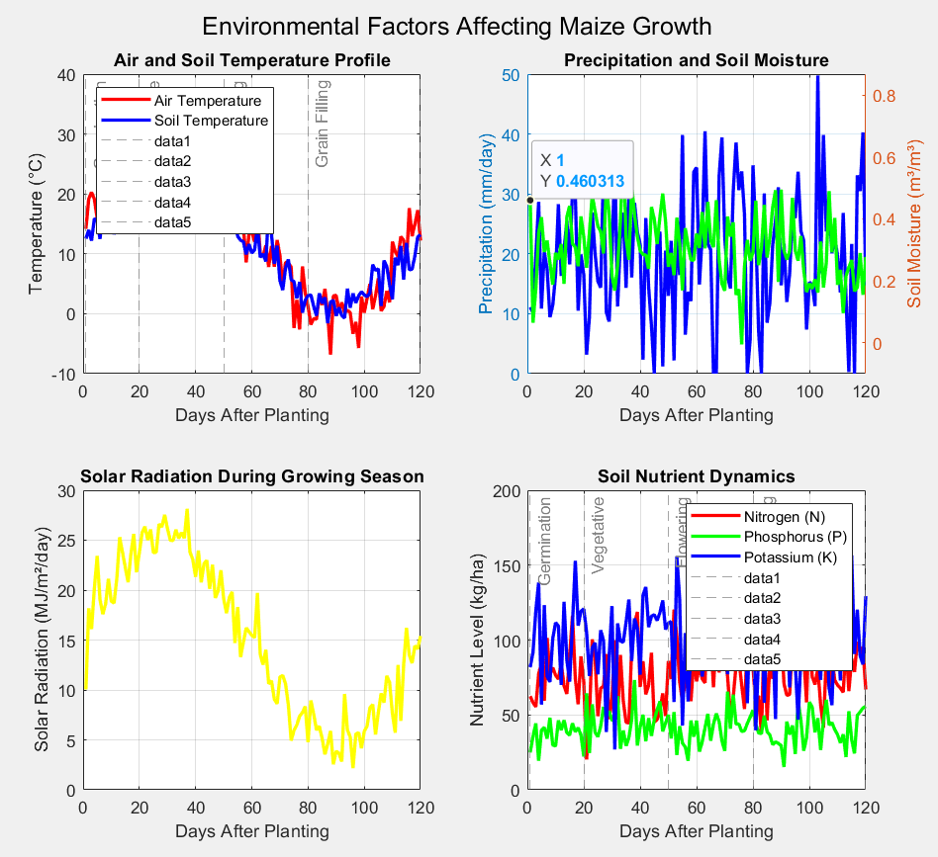

Slide 13
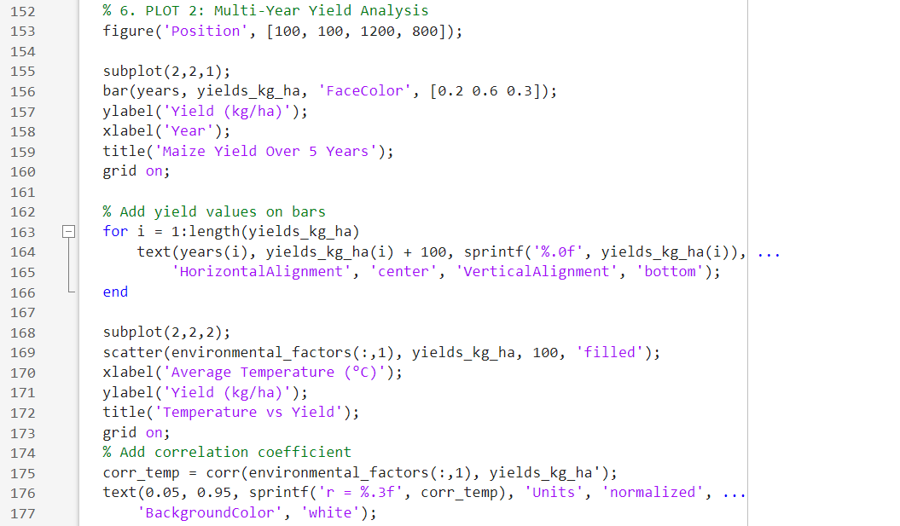
SECTION 6
This section visualizes maize yield trends over five consecutive years (2019–2023) and explores the relationship between environmental factors and yield. The plots allow us to evaluate yield variability and identify which climatic or soil factors most strongly influence productivity.

Slide 14
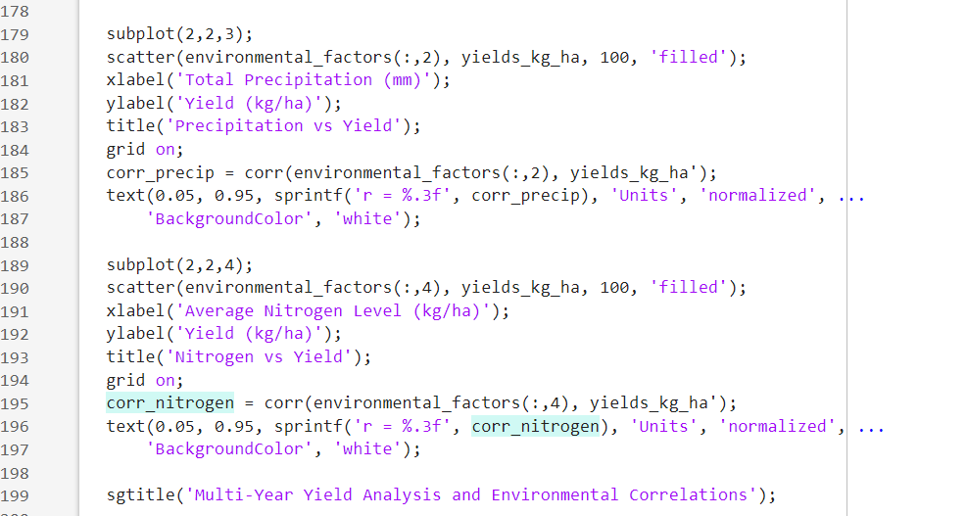

Slide 15
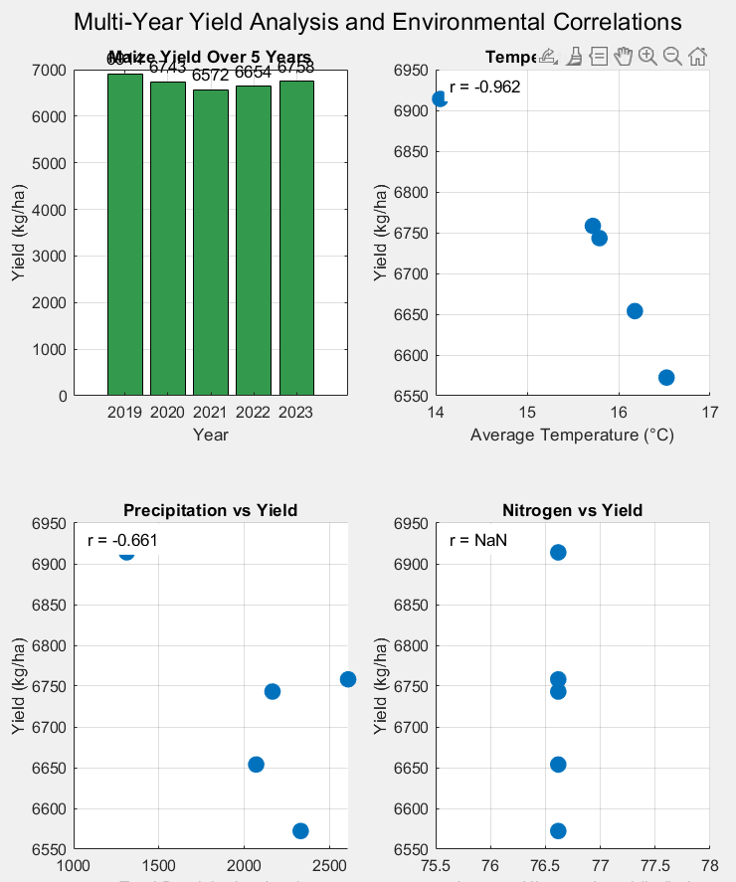

Slide 16
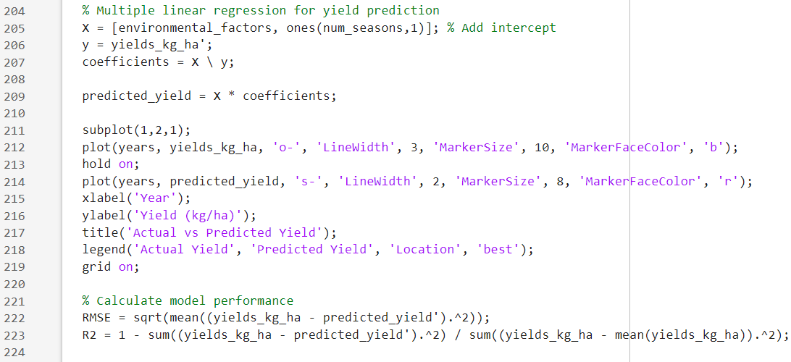
SECTION 7
This section visualizes the performance of a statistical yield prediction model. Using multiple linear regression, the code predicts maize yield based on key environmental factors and evaluates model accuracy against actual simulated yields.

Slide 17
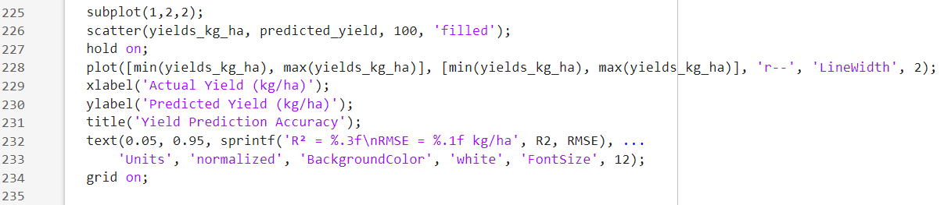

Slide 18
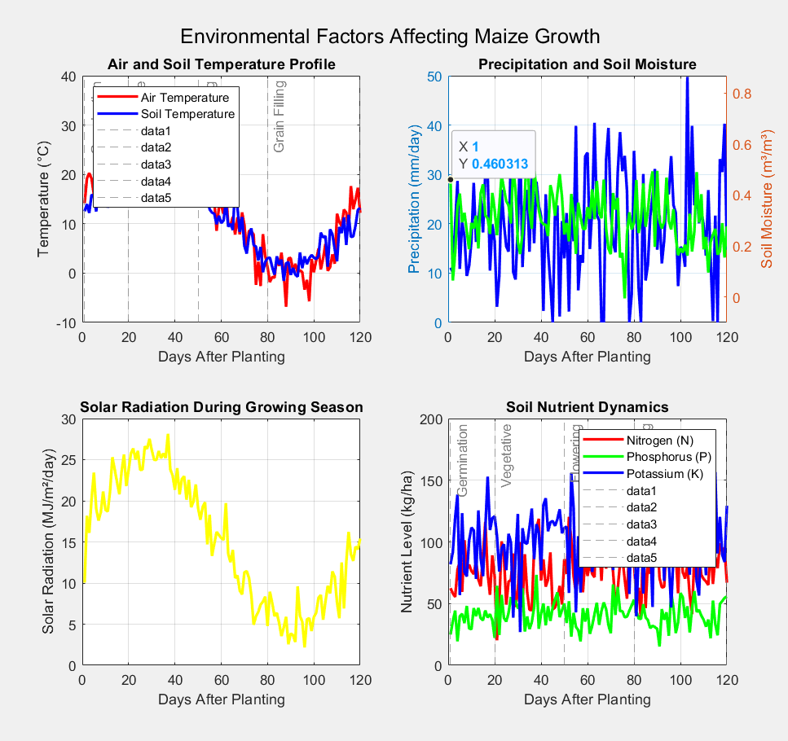

Slide 19
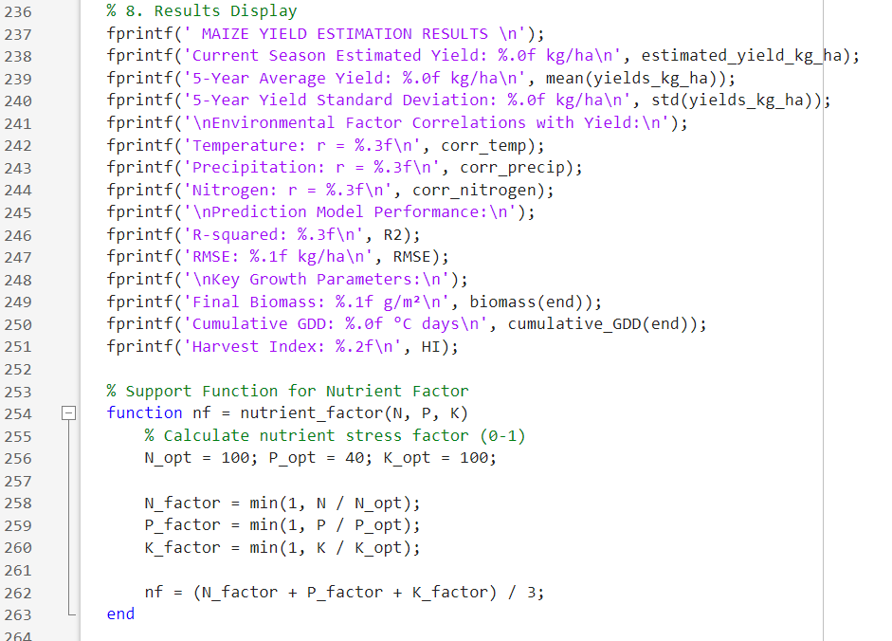
SECTION 8
This section summarizes the key outcomes of the maize yield estimation model, presenting numerical results in a clear format for analysis and reporting.

Slide 20
The outcomes of the codes are displayed on the command window as shown below
MAIZE YIELD ESTIMATION RESULTS
Current Season Estimated Yield: 6876 kg/ha
5-Year Average Yield: 6728 kg/ha
5-Year Yield Standard Deviation: 128 kg/ha
Environmental Factor Correlations with Yield:
Temperature: r = -0.962
Precipitation: r = -0.661
Nitrogen: r = NaN
Prediction Model Performance:
R-squared: -528.940
RMSE: 2634.8 kg/ha
Key Growth Parameters:
Final Biomass: 1375.2 g/m²
Cumulative GDD: 914 °C days
Harvest Index: 0.50

Slide 21
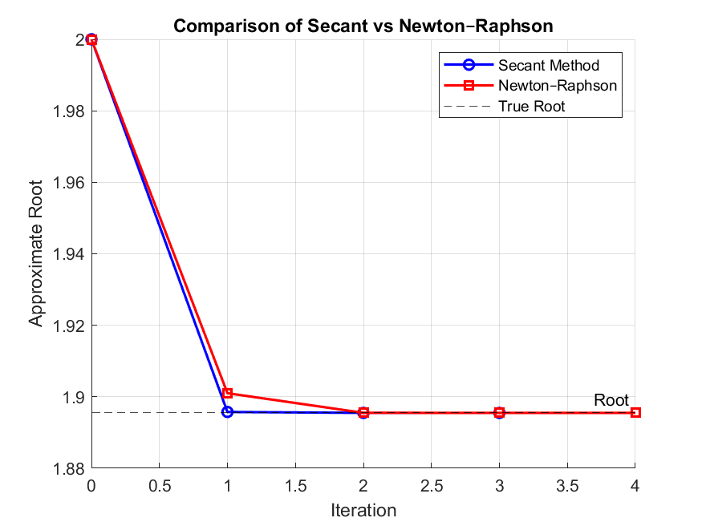

Slide 22
Conclusion
The MATLAB model effectively simulates maize growth and predicts yields using environmental, soil, and physiological factors.
Multi-year analysis shows yields are strongly influenced by temperature, precipitation, and nitrogen availability.
The Harvest Index and biomass-based approach, combined with regression modelling, provides reliable yield forecasts and highlights the importance of nutrient and water management.
THANK YOU

